Slide 1


模拟电子技术基础
Analog Device
6 Feedback amplifier circuit
反馈放大电路
陈晓龙 Chen, Xiaolong
Department of Electrical and Electronic Engineering

Slide 2






6.0 What is feedback
An example of feedback in our daily life
某
某 宝
Amazon
Positive feedback
Negative feedback

Slide 3
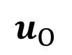
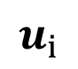
Application of negative feedback in stabilizing the static working point Q
DC circuit
V_{CC}
V_{CC}
R_{B2}
I₂
R_{C}
I_{CQ}
R_{B2}
R_{C}
+
c
R_{B1}
c
U_{BQ}
T
T
b
b
e
+
e
U_{EQ}
R_{B1}
I₁
-
R_{E}
R_{E}
I_{EQ}
-

Slide 4
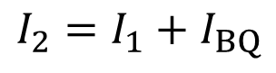
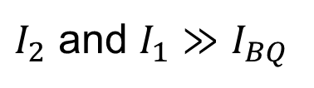
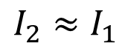
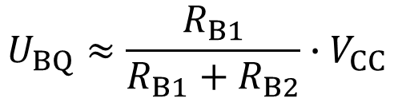
Working principle
V_{CC}
R_{B2}
I₂
R_{C}
I_{CQ}
I_{BQ}
c
To make Q point stable, we let
U_{BQ}
T
b
e
R_{B1}
I₁
U_{EQ}
R_{E}
I_{EQ}
Then U_{BQ} is unrelated to temperature
T ↑
I_{CQ} ↑
I_{EQ} ↑
U_{EQ} ↑
U_{BEQ}= U_{BQ}- U_{EQ}
I_{CQ} ↓
I_{BQ} ↓
U_{BEQ} ↓

Slide 5
V_{CC}
R_{B2}
I₂
R_{C}
I_{CQ}
I_{BQ}
c
U_{BQ}
T
Output circuit
b
e
R_{B1}
U_{EQ}
I_{EQ}
Input circuit
R_{E}
Feedback network 反馈网络
Feedback 反馈:
In electronic circuits, the output signal is transported back to the input circuit, and influence the input signal.

Slide 6
Feedback types
Positive feedback
正反馈
Negative feedback
负反馈
DC feedback
直流反馈
AC feedback
交流反馈

Slide 7
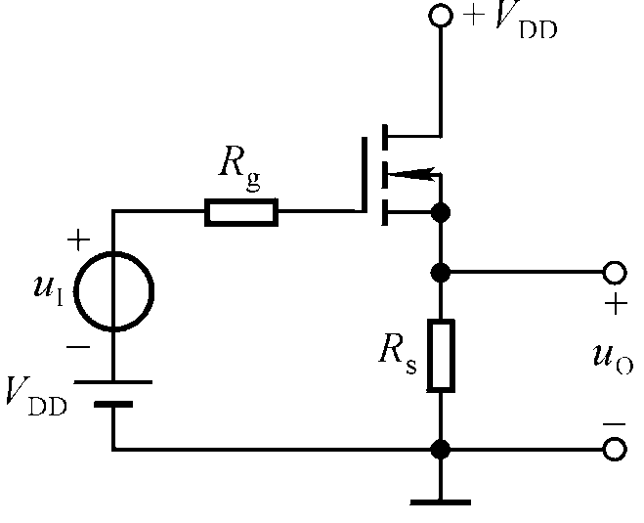
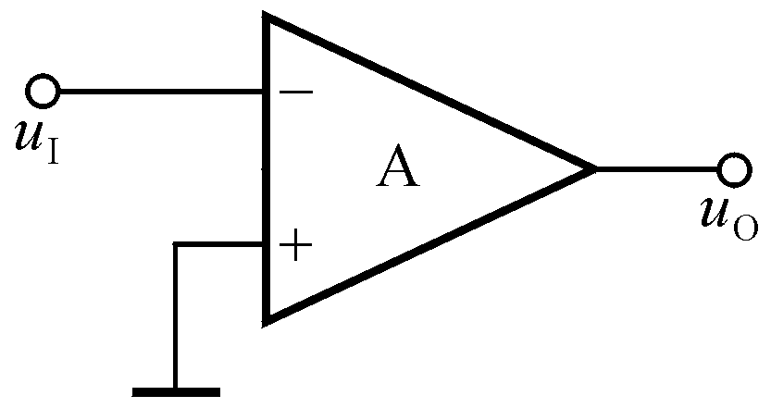
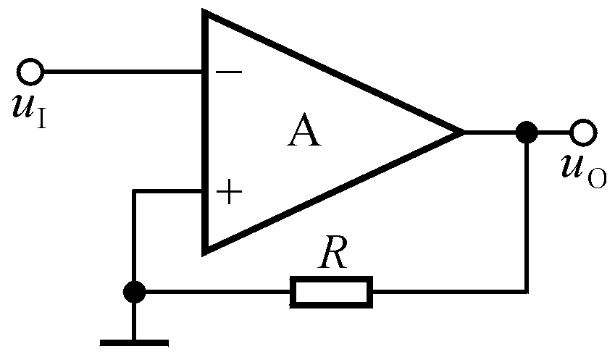
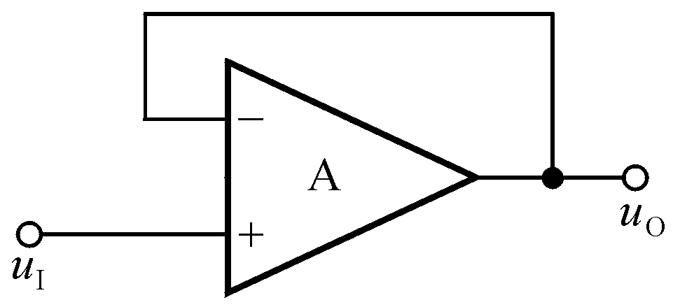
6.1 Judgment method of feedback types
Whether there is feedback or not? 有无反馈？
No
No
Yes
Yes

Slide 8
The block diagram of feedback amplifier circuit
反馈放大电路方框图
净输入量
Input signal
+
The net input signal
Amplifier circuit
Output signal
Comparing 比较
Feedback signal
Feedback network

Slide 9
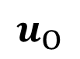
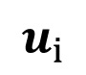
How to judge the DC and AC feedback 判断直流和交流反馈
Example 1:
DC circuit
V_{CC}
V_{CC}
R_{B2}
R_{B2}
I₂
R_{C}
I_{CQ}
R_{C}
C₂
C₁
+
c
c
U_{BQ}
T
T
b
b
e
+
e
R_{L}
U_{EQ}
R_{B1}
R_{B1}
I₁
-
R_{E}
C_{E}
R_{E}
I_{EQ}
-
There is DC feedback!

Slide 10
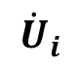
Example 1:
V_{CC}
AC circuit
R_{B2}
R_{C}
C₂
c
C₁
c
T
b
T
+
e
R_{C}
R_{L}
b
+
e
R_{L}
R_{B2}
R_{B1}
-
R_{B1}
-
R_{E}
C_{E}
There is no AC feedback!

Slide 11
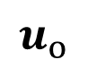
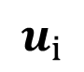
Example 2: Do DC and AC feedback exist in the circuit?
DC circuit
V_{CC}
V_{CC}
R_{B2}
R_{C}
R_{B2}
I₂
R_{C}
I_{CQ}
C₂
C₁
c
+
c
T
U_{BQ}
T
b
b
+
e
R_{L}
e
R_{B1}
R_{B1}
I₁
U_{EQ}
-
R_{E}
R_{E}
I_{EQ}
-
There is DC feedback!

Slide 12
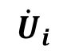
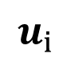
Example 2:
V_{CC}
AC circuit
R_{B2}
R_{C}
C₂
c
C₁
c
T
b
T
+
e
R_{C}
R_{L}
b
+
e
R_{L}
R_{B2}
R_{B1}
-
R_{E}
R_{B1}
-
R_{E}
C_{E}
There is AC feedback!

Slide 13

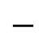


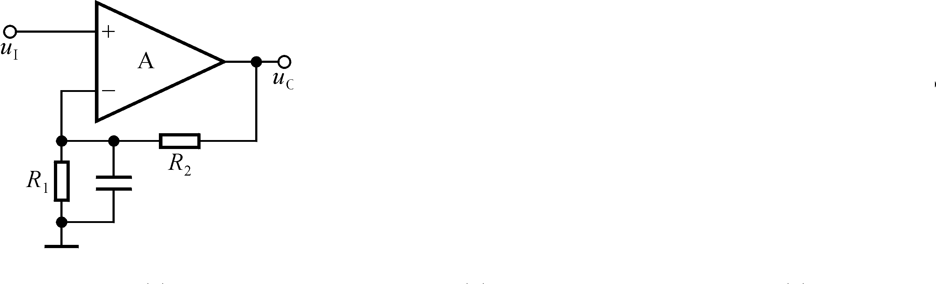
DC circuit
Example 3:
u_{I}
u_{O}
R₁
R₂
DC feedback!
AC circuit
u_{I}
u_{O}
R₂
No AC feedback!

Slide 14
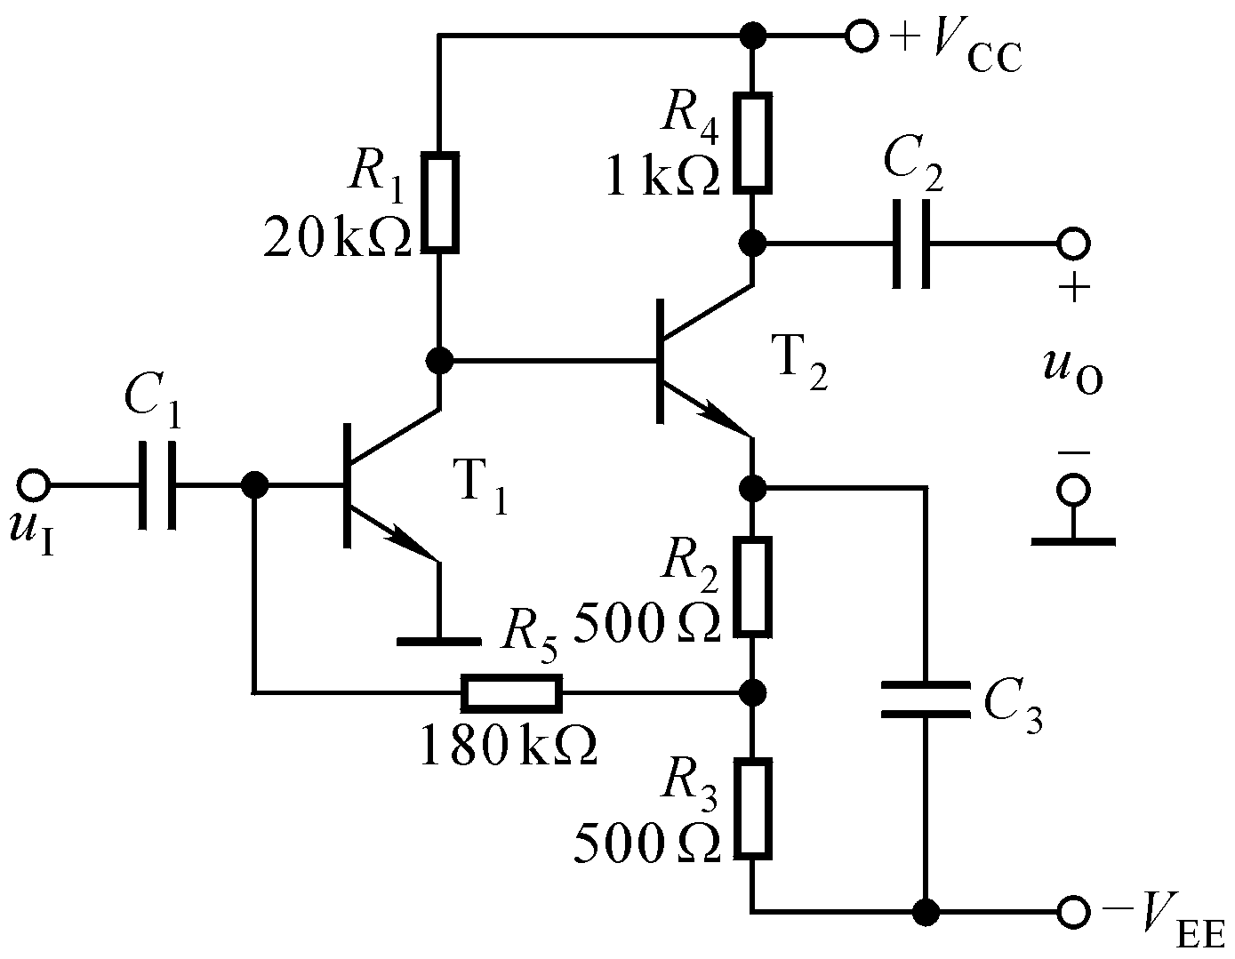
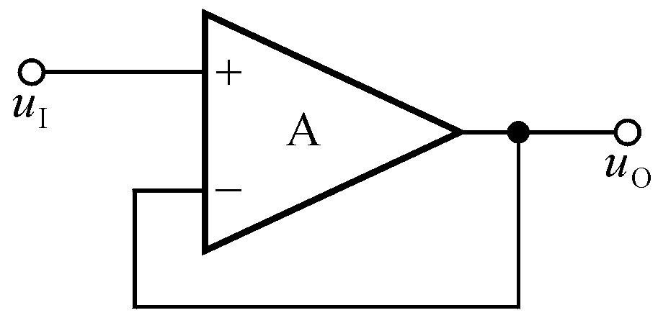
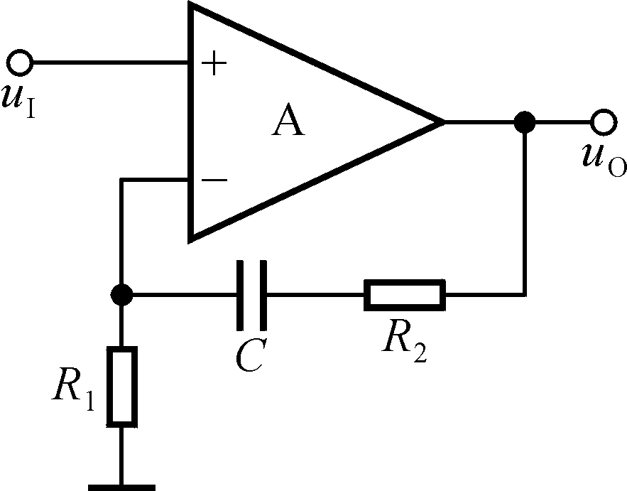

Slide 15
Positive and negative feedback 正反馈与负反馈
净输入量
Input signal
+
The net input signal
Amplifier circuit
Output signal
Comparing 比较
Feedback signal
Feedback network
The net input signal > input signal: positive feedback
Can be applied in oscillator 振荡器
The net input signal < input signal: negative feedback
Improve the performance of amplifier circuit
Signal operation 信号运算

Slide 16
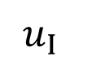
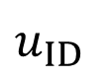
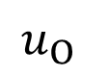
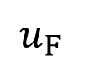

How to judge the positive and negative feedback
+
Amplifier circuit
Feedback network

Slide 17
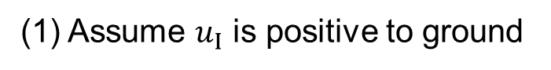


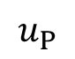

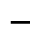
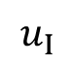


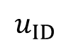
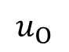
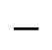

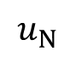
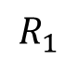
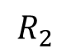
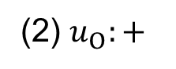
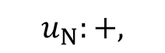
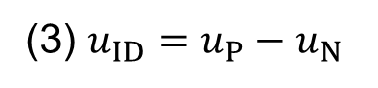

Example 1: Positive or negative feedback?
u_{I}
u_{ID}
u_{O}
R₁
R₂
Negative feedback

Slide 18

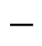

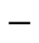


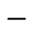
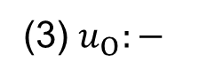
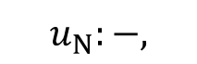
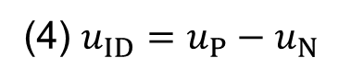

Example 2: Positive or negative feedback?
u_{I}
u_{ID}
u_{O}
R₁
R₂
Positive feedback

Slide 19
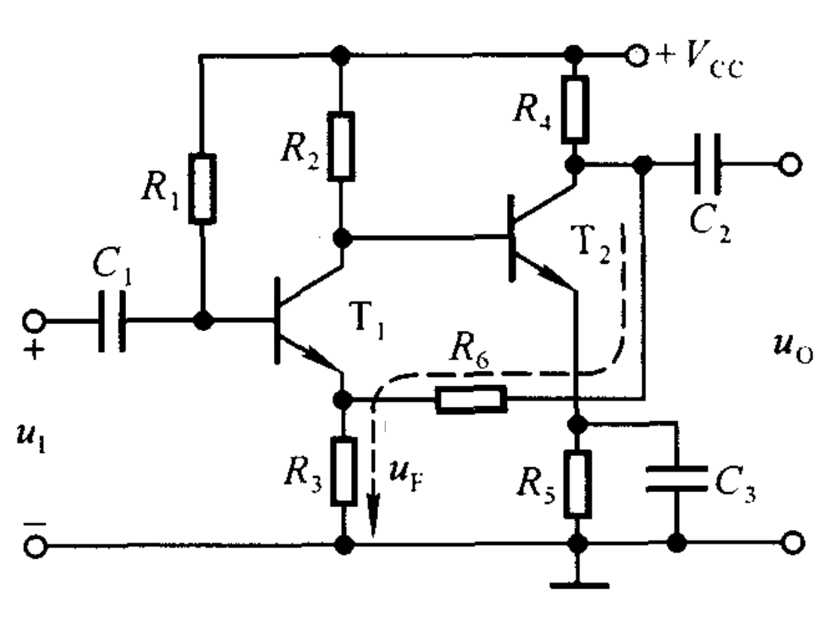




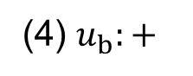



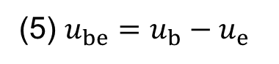

Example 3: Positive or negative feedback for AC circuit?
(1) Draw the AC circuit
(2) Find amplifier circuit and feedback circuit
b
Amplifier
e
Negative feedback
Feedback

Slide 20
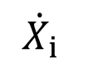
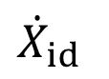



6.2 AC negative feedback amplifier circuits
Output terminal
输出端
Voltage feedback 电压反馈
Current feedback 电流反馈
Voltage feedback 电压反馈
+
Amplifier circuit
Feedback network

Slide 21








Voltage feedback 电压反馈
+
Amplifier circuit
Feedback network
The feedback network is in parallel connection with R_{L}
The feedback signal is proportional to the output voltage

Slide 22








Current feedback
+
Amplifier circuit
Feedback network
The feedback network is in series connection with R_{L}
The feedback signal is proportional to the output current

Slide 23











How to judge the voltage and current feedback?
+
Amplifier circuit
Feedback network

Slide 24











Input terminal
输入端
Series feedback 串联反馈
Parallel feedback 并联反馈
Series feedback
Amplifier circuit
Feedback network

Slide 25












Series feedback
Amplifier circuit
Feedback network
The feedback network is in series connection with the input circuit
The feedback signal is voltage signal

Slide 26








Parallel feedback
Amplifier circuit
Feedback network
The feedback network is in parallel connection with the input circuit
The feedback signal is current signal

Slide 27












How to judge the series and parallel feedback?
Parallel feedback
Series feedback

Slide 28
In total, there are 4 type AC negative feedback circuits
Voltage series feedback 电压串联反馈
Voltage parallel feedback 电压并联反馈
Current series feedback 电流串联反馈
Current parallel feedback 电流并联反馈

Slide 29















Voltage series feedback
Feedback factor
Open loop gain
Close loop gain

Slide 30











Voltage parallel feedback
Feedback factor
Open loop gain
Close loop gain

Slide 31







Current series feedback
Feedback factor
Open loop gain
Close loop gain

Slide 32





Current parallel feedback
Feedback factor
Open loop gain
Close loop gain

Slide 33
Summary of 4 type AC negative feedback circuits
 |  |  |  | Functionality
Voltage series |  |  |  | Voltage amplification
Voltage parallel |  |  |  | Convert current to voltage
Current series |  |  |  | Convert voltage to current
Current parallel |  |  |  | Current amplification

Slide 34











Example 1:
(1) Negative or positive feedback for AC circuit?
V_{CC}
R_{B2}
C₁
c
T
b
C₂
e
R_{B1}
R_{E}
R_{L}
Negative feedback !

Slide 35










Example 1:
(2) Judge the type of the negative feedback circuit
V_{CC}
R_{B2}
Voltage feedback!
c
C₁
T
b
C₂
e
Series feedback!
R_{B1}
R_{E}
R_{L}
Voltage series feedback!

Slide 36














Example 1:
(3) The working principle of stabilizing the output voltage
V_{CC}
R_{B2}
C₁
c
T
b
C₂
e
R_{B1}
R_{E}
R_{L}

Slide 37





























Example 2:
V_{CC}
(1) Negative or positive feedback for AC circuit?
R_{C}
C₂
c
C₁
R₁
T
R_{S}
R_{L}
c
R₁
T
Negative feedback !
R_{S}
R_{C}
R_{L}

Slide 38














Example 2:
(2) Judge the type of the negative feedback circuit
R₁ is in parallel connection with R_{L}
Voltage feedback!
c
R₁
c
T
R₁
R_{S}
R_{C}
R_{L}
R_{S}
R_{C}
R_{L}
r_{be}
Voltage parallel feedback!

Slide 39









Example 2:
(2) Judge the type of the negative feedback circuit
c
R₁
T
R_{S}
R_{C}
c
R₁
R_{S}
R_{C}
Voltage feedback!
r_{be}

Slide 40







Example 2:
(3) The working principle of stabilizing the output voltage
c
R₁
T
R_{S}
R_{C}
R_{L}

Slide 41















Example 3:
(1) DC or AC feedback?
Both DC feedback and AC feedback exists!
V_{CC}
R_{L}

Slide 42








Example 3:
(2) Negative or positive feedback for AC circuit?
V_{CC}
R_{L}
Negative feedback!

Slide 43



Example 3:
(3) The type of AC negative feedback
Feedback network in series connection with output terminal
V_{CC}
R_{L}
Current feedback!
Series feedback!
Current series feedback!

Slide 44























Example 3:
(4) The working principle of stabilizing the output current
V_{CC}
R_{L}

Slide 45


Slide 46


Slide 47


Slide 48
Homework:
Refer to blackboard

